Slide 1


Shelter Technical Working Group
Meeting 9 September 2025

Slide 2
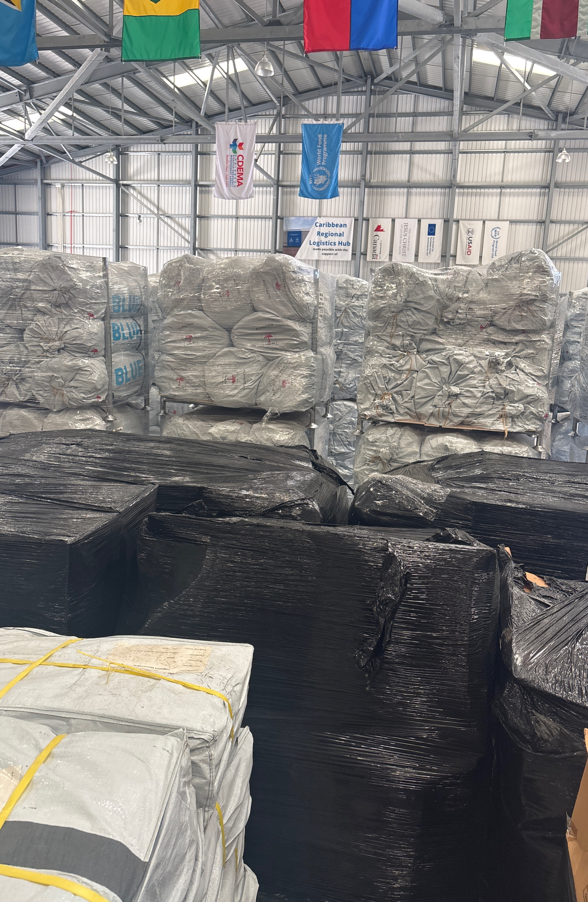
Agenda
Introductions
Discussion on scope and shared vision of Shelter Technical Working Group
Exchange expertise, priority needs and opportunities for collaboration
Communication and coordination mechanisms
Agency updates
AOB

Slide 3






















Introductions
Put your Name & Organization
in the chat

Slide 4
2. Scope and shared vision
Scope of the Shelter Sector in The Caribbean:
  Emergency response (Non food items / cash distributions / procurement)
  Management of Emergency shelter / Collective Centers / sites
  Shelter related “protection” including GVB, Child protection, PSEA, disability inclusion etc.
  House and settlement construction and repairs, including planned relocations
  Community & household preparedness / simulations / campaigns

Slide 5
2. Scope and shared vision
Embedded in the RRM

Slide 6
2. Scope and shared vision STWG
Formal reporting in the CDPG (Caribbean Development Partners Group)
Leading the response strategy of the sector during emergencies
Coordinating the responses before / during and after a hazard strikes, in support of the national coordinating mechanisms

Slide 7
2. Scope and shared vision STWG
Inclusive: useful for all organizations, especially local organizations
The Caribbean (mainly english speaking / translation on request)
Interactive knowledge sharing between organizations
Information collection and sharing:
  Stocks, networks, staffing, funding, training, expertise…..
Adaptive…. responding to needs:
  “Zoom-in” sessions / subgroups on specific topics
FUN!!!

Slide 8
3. Exchange of expertise
Preparedness/Resilience and DRR | 86%
Emergency Shelter Management | 61%
Regional/National Coordination | 65%
Organizational Development | 65%
Non-food Item Procurement | 42%
Cash-based Interventions | 44%
Shelter Recovery | 60%
Public Awareness Campaigns | 68%
Psychosocial Health | 2%
Surveillance/Sanitation | 2%
Inclusive Measures for Disabilities | 2%
Building Bridges Partnerships | 2%
Safety and Protection | 2%
Post Mental Health Assistance | 2%
*Based on 57 respondent of STWG registration email.

Slide 9
3. Exchange of expertise
Please fill in the Microsoft form to express your needs.
https://forms.cloud.microsoft/e/qtcASM7c5V
Or just send a message to the co-leads
Jwegdam@iom.int (+1 242 809 6699) or tamara.lovell@cdema.org

Slide 10
4 Communication and Coordination
  Weekly online meetings: Tuesday 10.00 – 11.00 (time ok??)
  Register via:
  https://teams.microsoft.com/meet/3517166269485?p=ickvn0imTGddd9l8TG

Slide 11
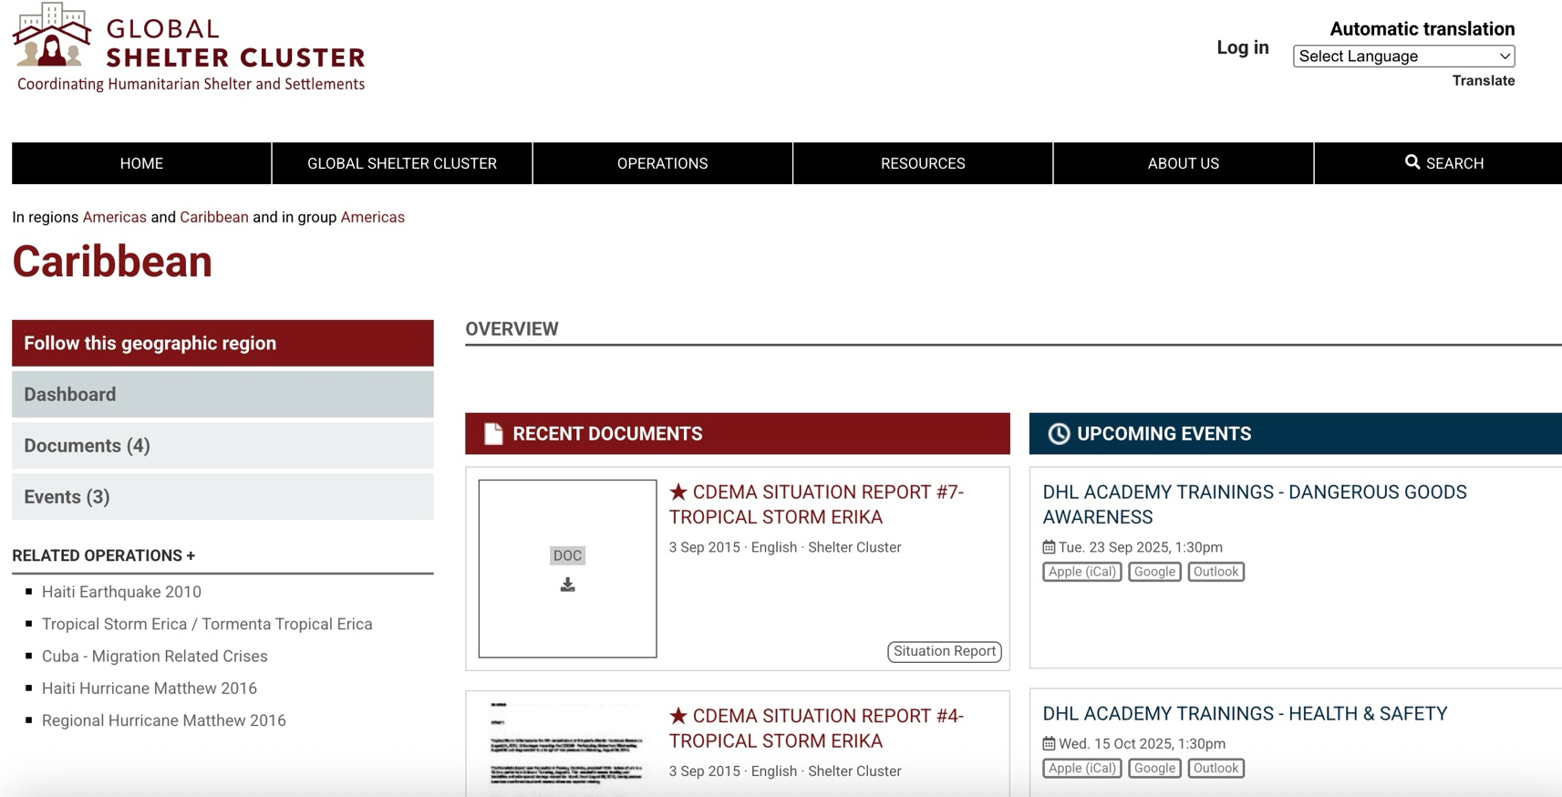
4 Communication and Coordination
STWG Website: https://sheltercluster.org/geographic-region/caribbean
Info about:
  Meetings
  Stocks
  Online trainings
  Guidance
  Previous responses

Slide 12

4 Communication and Coordination
Launch of the “Caribbean Shelter Community”
Caribbean Shelter Professionals that exchanges events, questions, resources, needs, links,……
Sub community under global shelter community

Slide 13
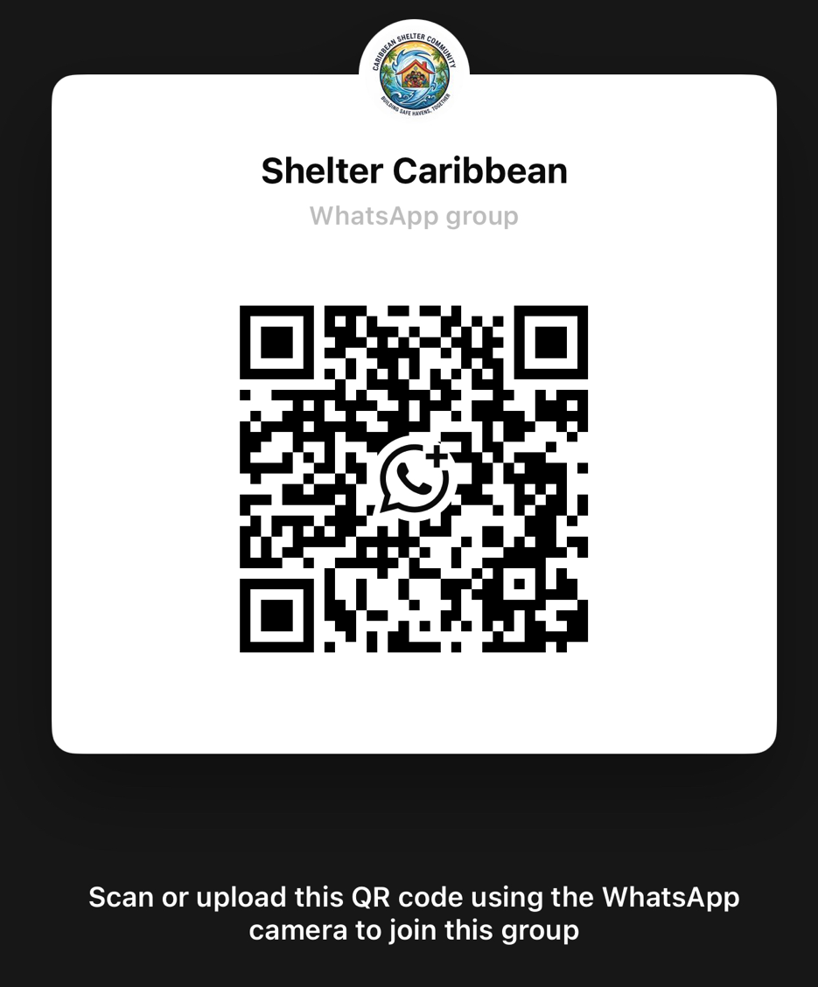
4 Communication and Coordination
Whatsapp group https://chat.whatsapp.com/DRjNs1JNN7GD75nF62MwHt?mode=ems_share_c

Slide 14
4 Communication and Coordination
Who wants to design a logo for the Caribbean Shelter Community?????

Slide 15
5 Agency updates
Current shelter related activities / plans
Any request from the Shelter Working group or network?

Slide 16
5 Agency updates
IOM:
Prepositioning Non-Food Items in Barbados
IOM is looking for implementing partners for assessment, reception, distribution and monitoring on Non-Food Items. IOM has secured funding for collaboration and training.
IFRC
Hurricane preparedness sessions

Slide 17
THANK YOU

